Slide 1

Aim Games Platform
The reference platform for game-making resources
Group 7
Speaker: Mario Bizcocho González

Slide 2
€1359 Million
Gross income figure of videogames in Spain in 2017 (AEVI)

Slide 3
€1359 Million
For reference
Spain’s Justice budget, 2018:
€1780 million

Slide 4
450 incorporated studios
Spain, 2017 (AEVI Yearly Report)
+620 unincorporated (estimate, Devuego) =
1070 national studios

Slide 5
The problem for small studios?
No easy access to assets and personnel

Slide 6
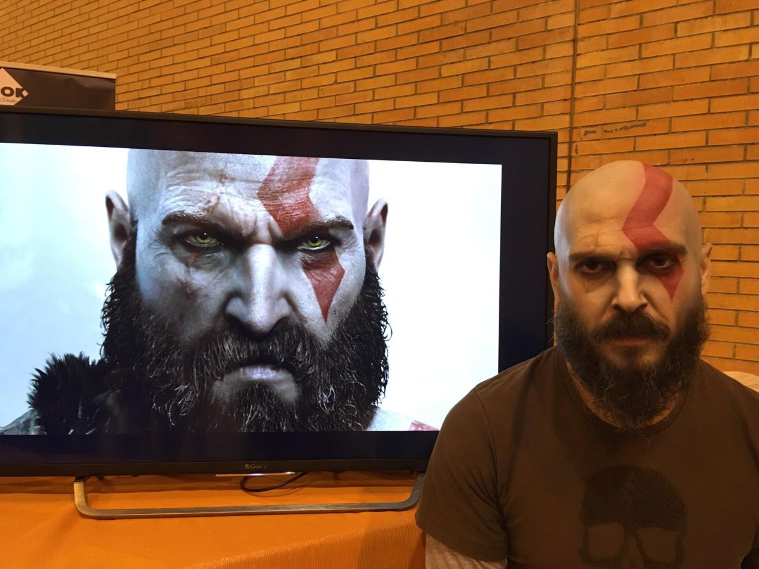

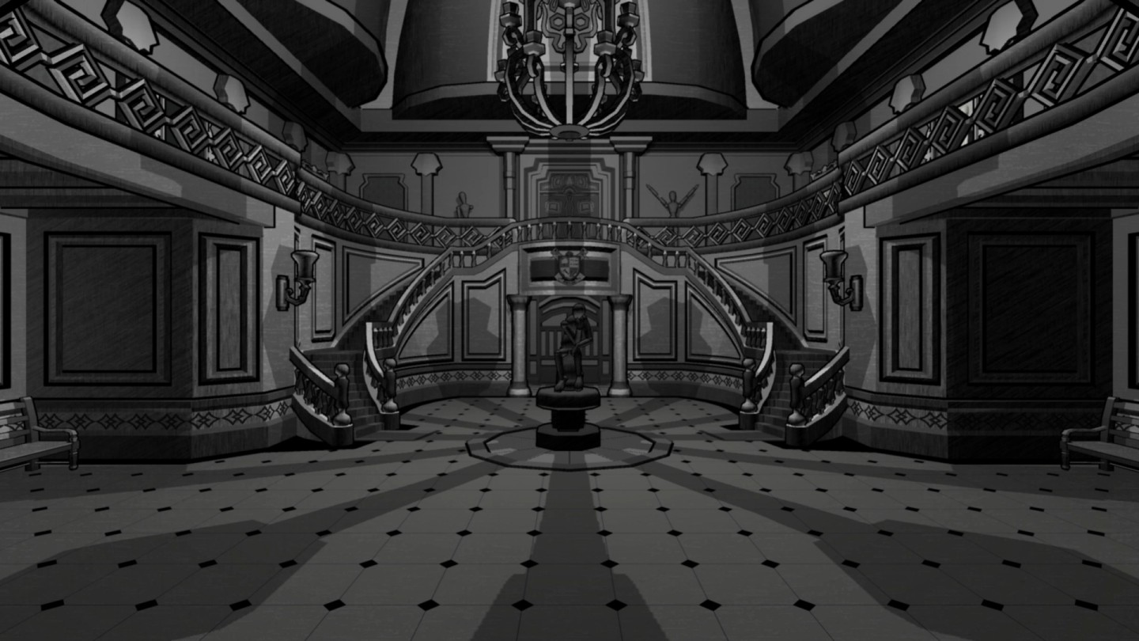

A representative case

Slide 7
Contents
What is Aim Games?
Core use cases
Pilot study
Competitor analysis
Differentiation
Cost and profit analysis
Development plan
Team composition
Technologies

Slide 8
Contents
What is Aim Games?
Core use cases
Pilot study
Competitor analysis
Differentiation
Cost and profit analysis
Development plan
Team composition
Technologies

Slide 9
What is Aim Games?
Asociación Andaluza para el Impulso de Videojuegos
Provides human and technological resources
Includes experienced professionals

Slide 10
Contents
What is Aim Games?
Core use cases
Pilot study
Competitor analysis
Differentiation
Cost and profit analysis
Development plan
Team composition
Technologies

Slide 11

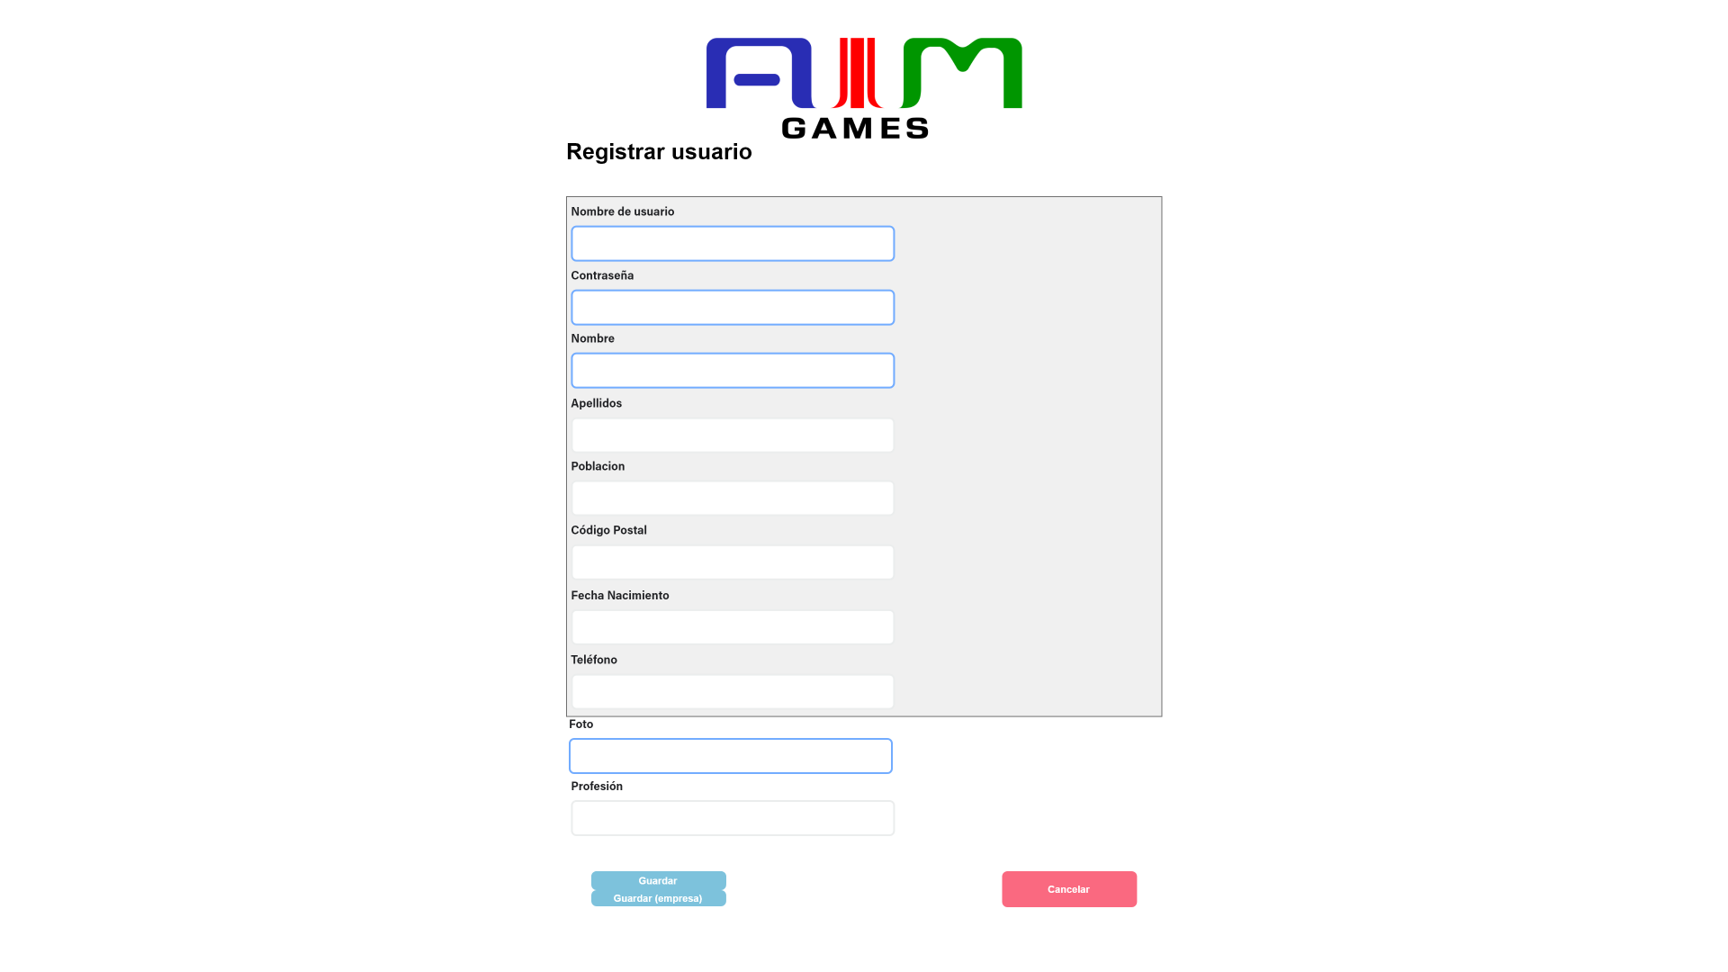
Core Use Cases
User management (base member, company, admin)
Notes:
Comment: business type is mainly matchmaking, with some paid service elements for company users (content database, outside mvp).

Slide 12

Core Use Cases
Posting job offer (company)
Related non-core: post job challenge (company)
Notes:
Comment: business type is mainly matchmaking, with some paid service elements for company users (content database, outside mvp).

Slide 13
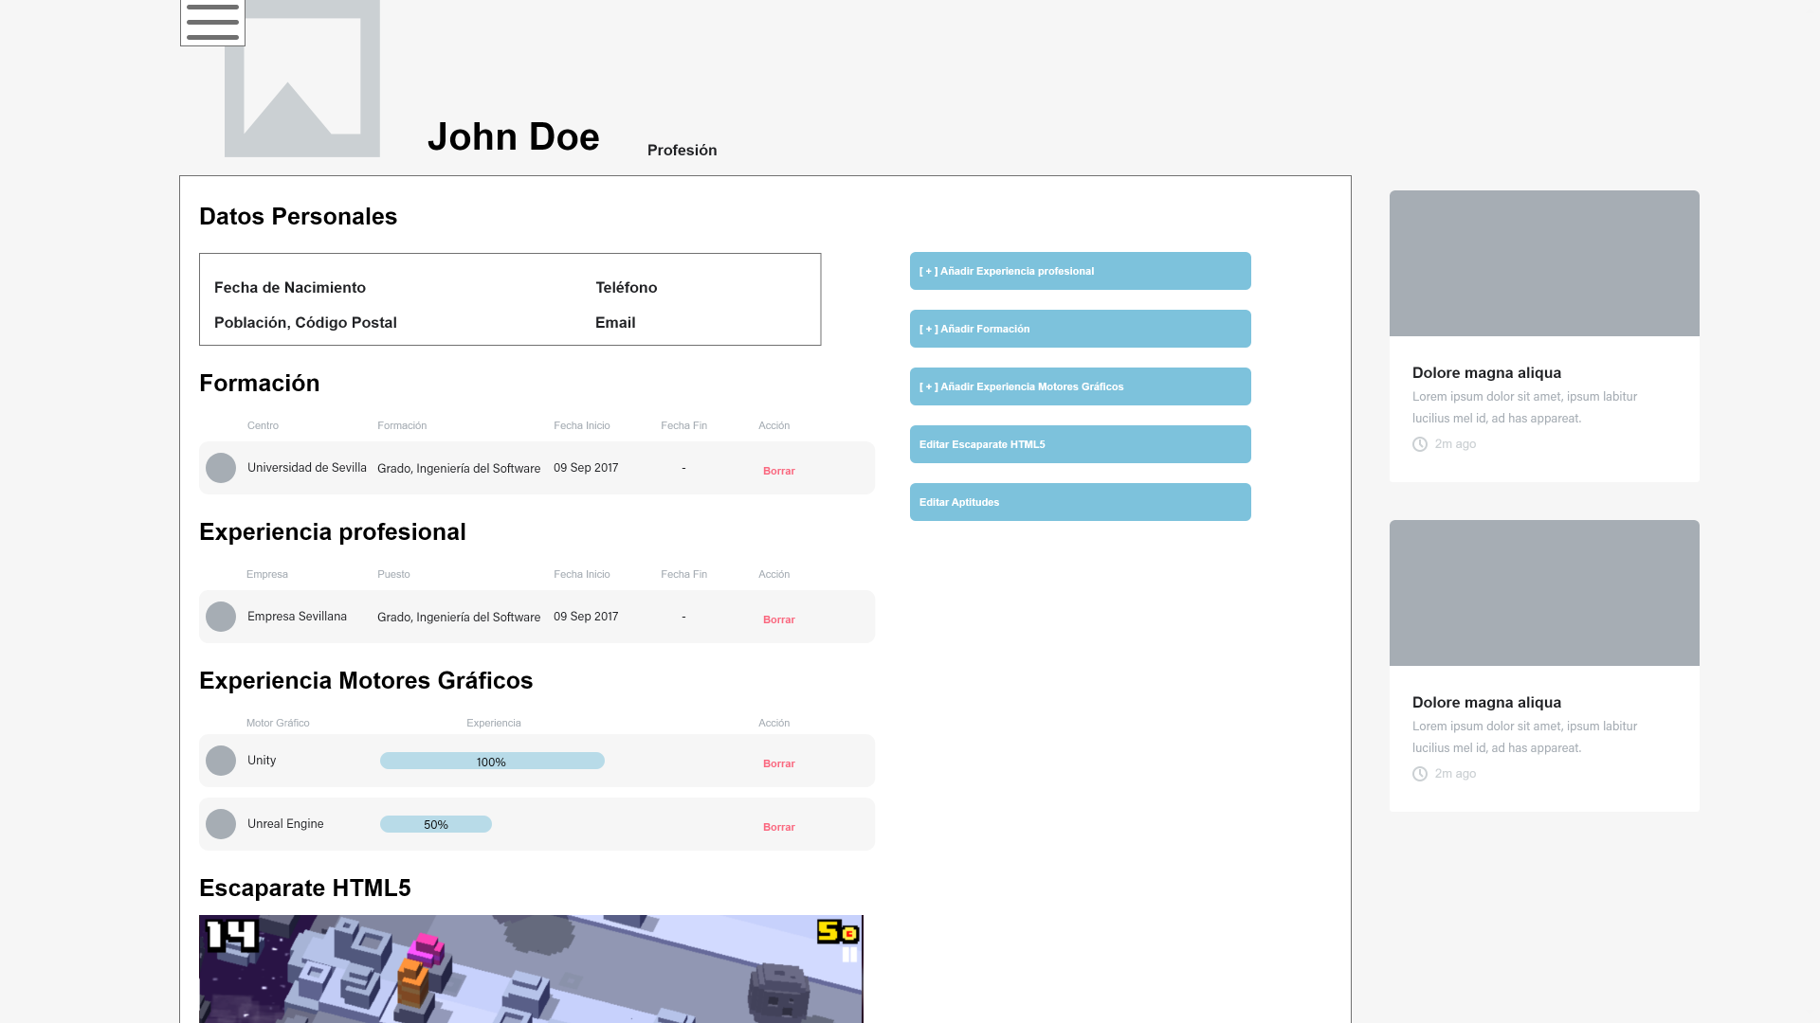
Core Use Cases
Posting curricula (base member)
Verifying curricula (admin)
Taking down fake/spam/inappropriate offers and curricula (admin)
Notes:
Comment: business type is mainly matchmaking, with some paid service elements for company users (content database, outside mvp).

Slide 14
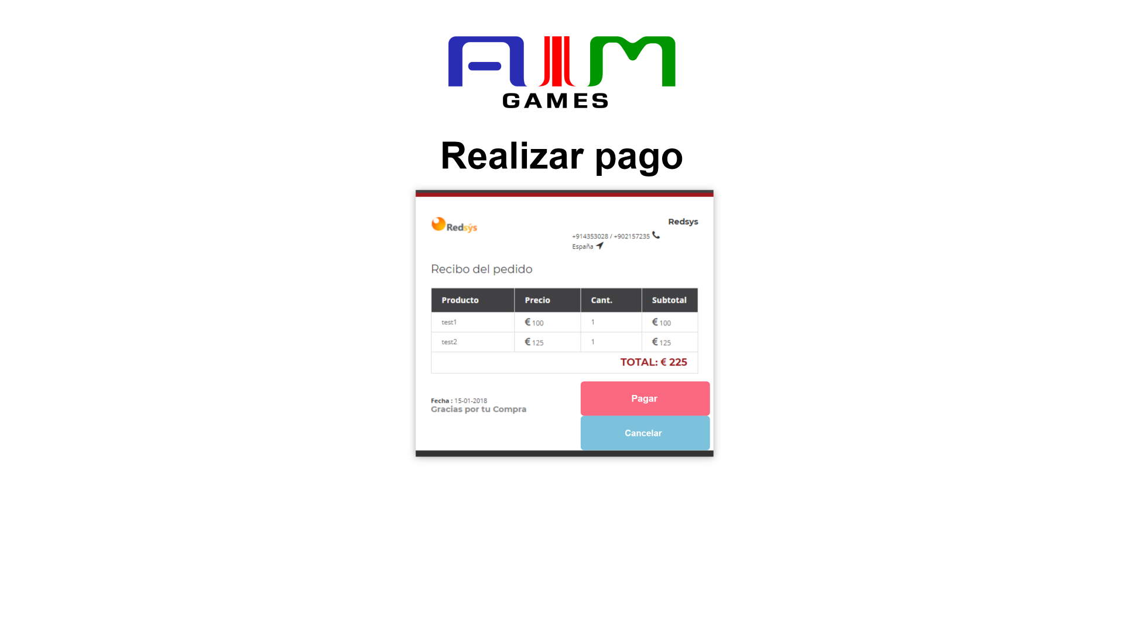
Core Use Cases
Paying for subscription (company)
Notes:
Comment: business type is mainly matchmaking, with some paid service elements for company users (content database, outside mvp).

Slide 15
Contents
What is Aim Games?
Core use cases
Pilot study
Competitor analysis
Differentiation
Cost and profit analysis
Development plan
Team composition
Technologies

Slide 16
Cost and profit analysis
Concept | Net cost
Direct costs (salaries, social costs, others) | €32258.01
Indirect costs | €322.58
Reserves | €3258.06
Profit | €4887.09
Total before tax | €40725.74
VAT (21%) | €8552.41
Total | €49278.15
Aids from the Ministry of Culture
Aids from regional governments
Company membership fees
Sublicensing administrative access to other associations
Notes:
Capital revenue: regional government aids to associations, company membership fees,

Slide 17
Cost and profit analysis
Name | Role | Price/hour | Invested hours | Gross Salary | Social costs | Total
De la Fuente Bonilla, Fco. Javier | CEO, Project Manager | 25€/h | 150h | 3750€ | 1124.63€ | 4874.63€
Molina Domínguez, Jorge Manuel | CCO, CIO | 22,73€/h | 150h | 3409,5€ | 1022.51€ | 4432.01€
Bizcocho González, Mario | CMO, Speaker | 22,73€/h | 150h | 3409,5€ | 1022.51€ | 4432.01€
Monteseirín Puig, Alejandro | Full-stack Developer | 18,54€/h | 150h | 2781€ | 834.03€ | 3615.03€
Pérez Piñero, Iván | Backend Developer | 15,37€/h | 150h | 2305.5€ | 689.35€ | 2994.85€
Arenas Arenas, Antonio | Frontend Developer | 15,37€/h | 150h | 2305.5€ | 689.35€ | 2994.85€
Santos Batista, Miguel | Full-stack Developer | 18,54€/h | 150h | 2781€ | 834.03€ | 3615.03€
Pazo Jiménez, Pablo | Backend Developer | 15,37€/h | 150h | 2305.5€ | 689.35€ | 2994.85€
 |  |  |  | 23047,5€ | 6905.76€ | 29953,75€
Notes:
Capital revenue: regional government aids to associations, company membership fees,

Slide 18
Cost and profit analysis
Notes:
Capital revenue: regional government aids to associations, company membership fees,

Slide 19
Cost and profit analysis
Notes:
Capital revenue: regional government aids to associations, company membership fees,

Slide 20
Contents
What is Aim Games?
Core use cases
Pilot study
Competitor analysis
Differentiation
Cost and profit analysis
Development plan
Team composition
Technologies

Slide 21
Development plan
Strengths
Current technologies
Motivation
Sector-centered
Flexible schedule
Weaknesses
Limited capital
Lack of familiarity
Lack of experience
Opportunities
No equivalent
State financing
Connected customers
Collaborations
Easy geographical expansion
Threats
Currently unknown association
Competitor arisal
Limited customer funds

Slide 22







Development plan
Communication
Management
Code repository

Slide 23
Development plan
Sprint 1
Core use cases
Sprint 2
Sprint 3
Apr 22 – May 3
Apr 1 - 12
March 18 - 29
Piloting & MVP
Polish MVP with piloting

Slide 24
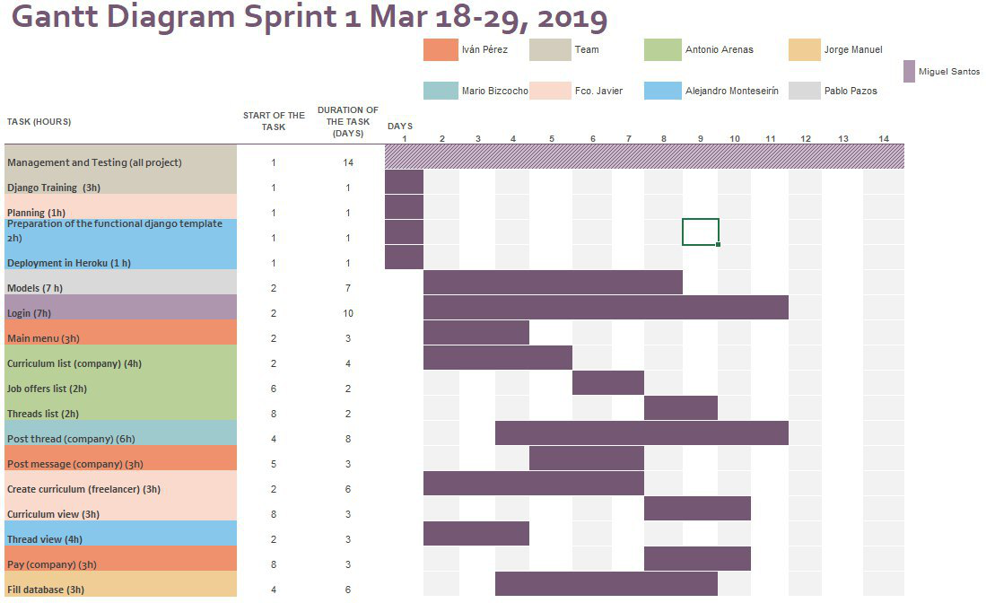
Development plan

Slide 25
Contents
What is Aim Games?
Core use cases
Pilot study
Competitor analysis
Differentiation
Cost and profit analysis
Development plan
Team composition
Technologies

Slide 26





Technologies

Slide 27
Contents
What is Aim Games?
Core use cases
Pilot study
Competitor analysis
Differentiation
Cost and profit analysis
Development plan
Team composition
Technologies

Slide 28
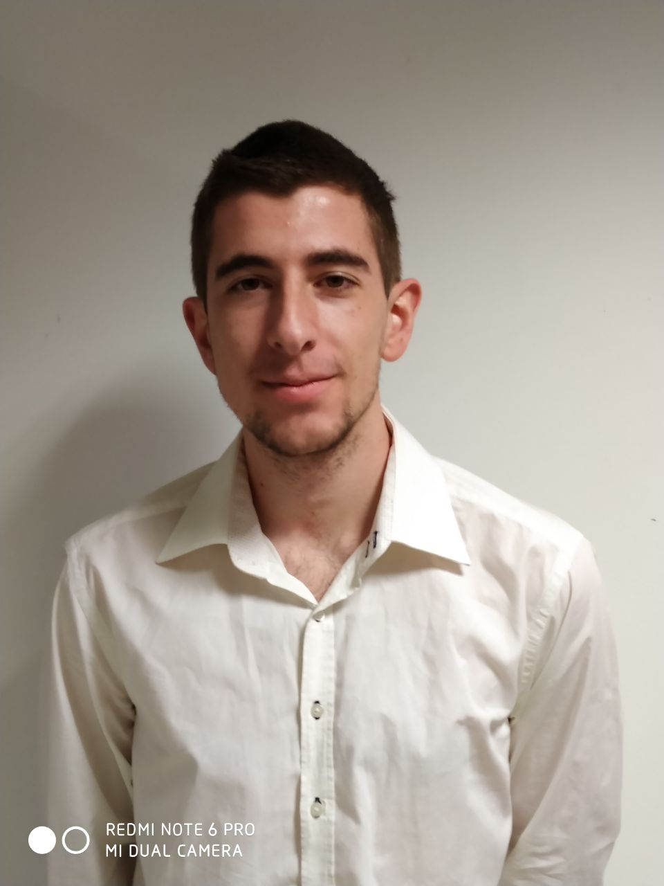
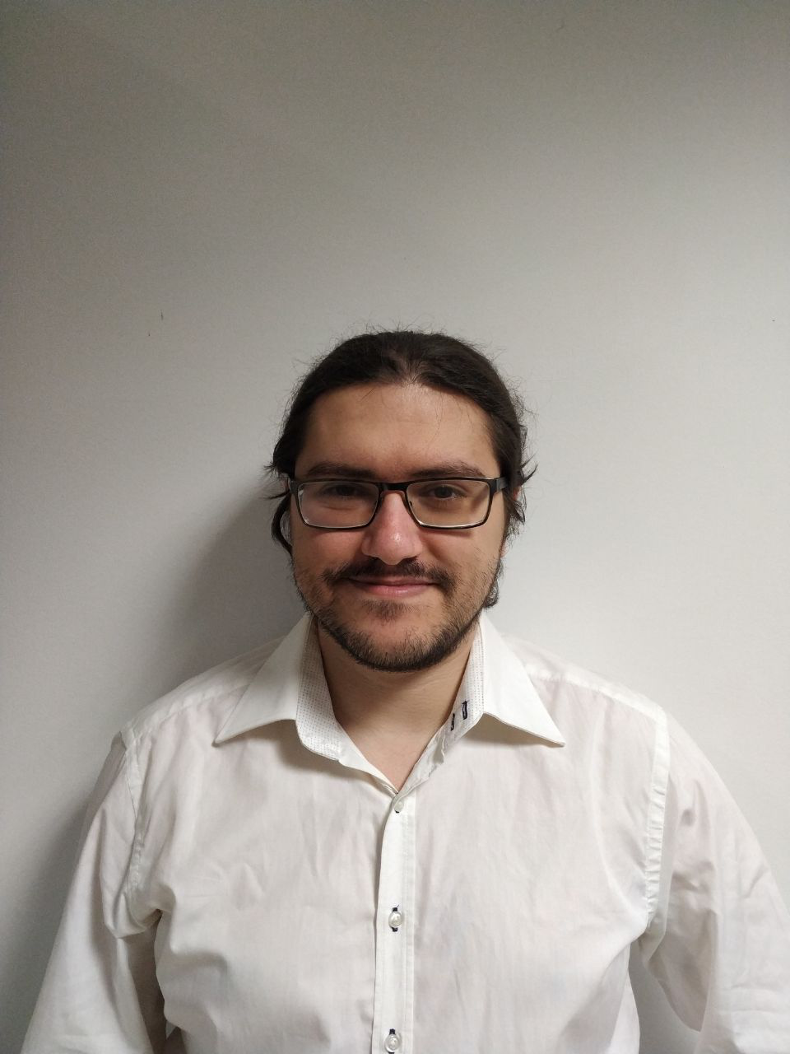
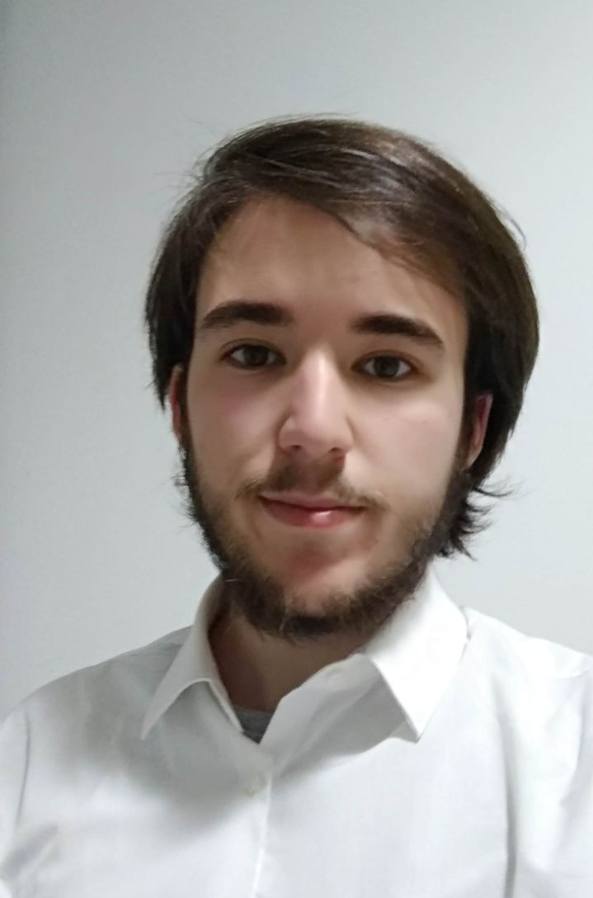
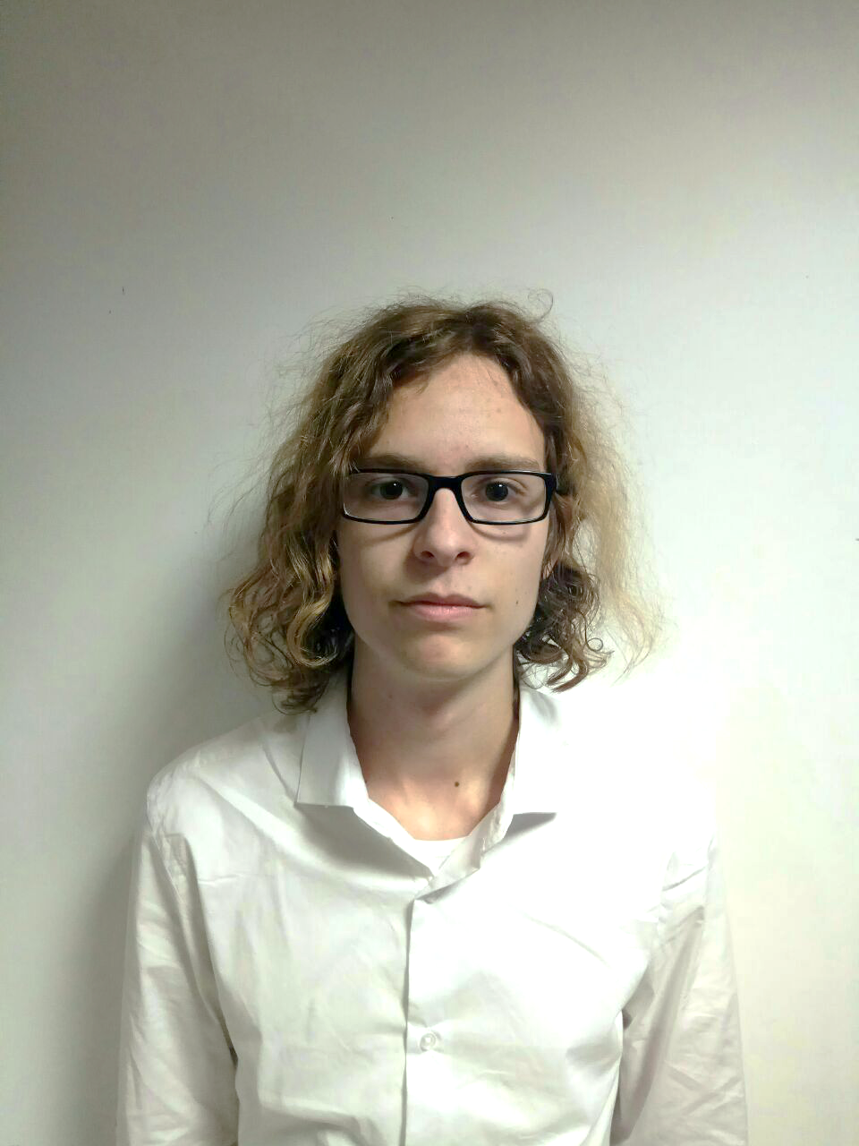
Team composition
Fco. Javier de la Fuente Bonilla | Jorge Manuel Molina Domínguez | Mario Bizcocho González | Alejandro Monteseirín Puig
Project manager, CEO | CCO, CIO | Speaker, CMO | Full-stack developer
Notes:
Grupo 7

Slide 29
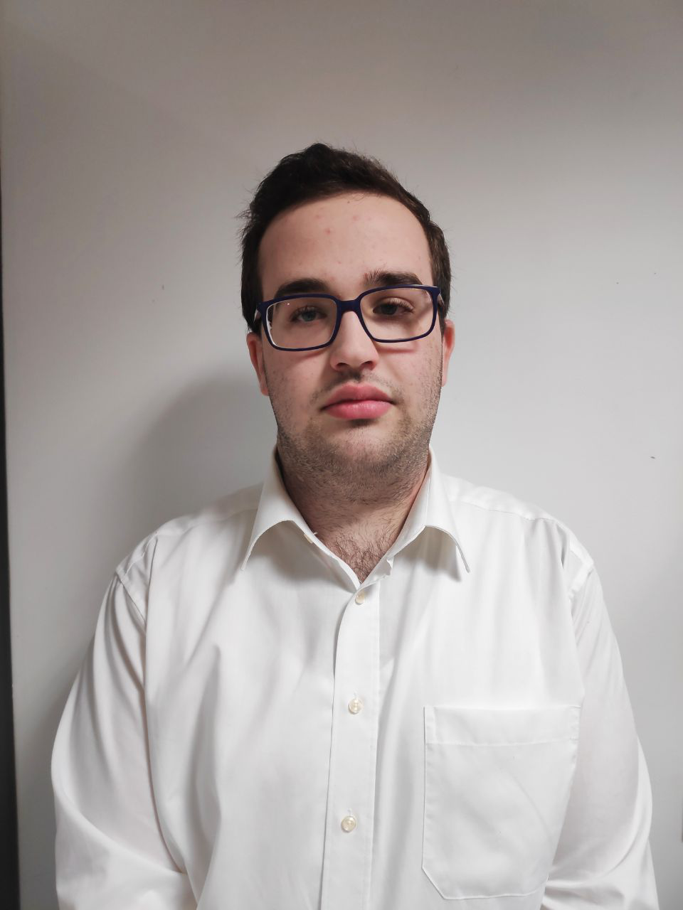
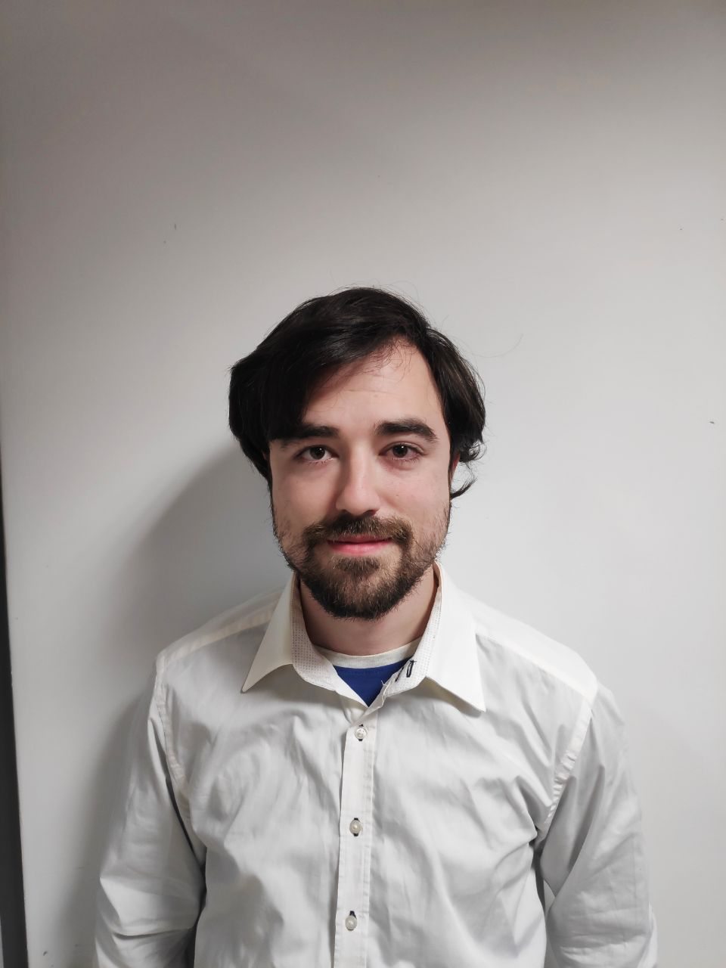
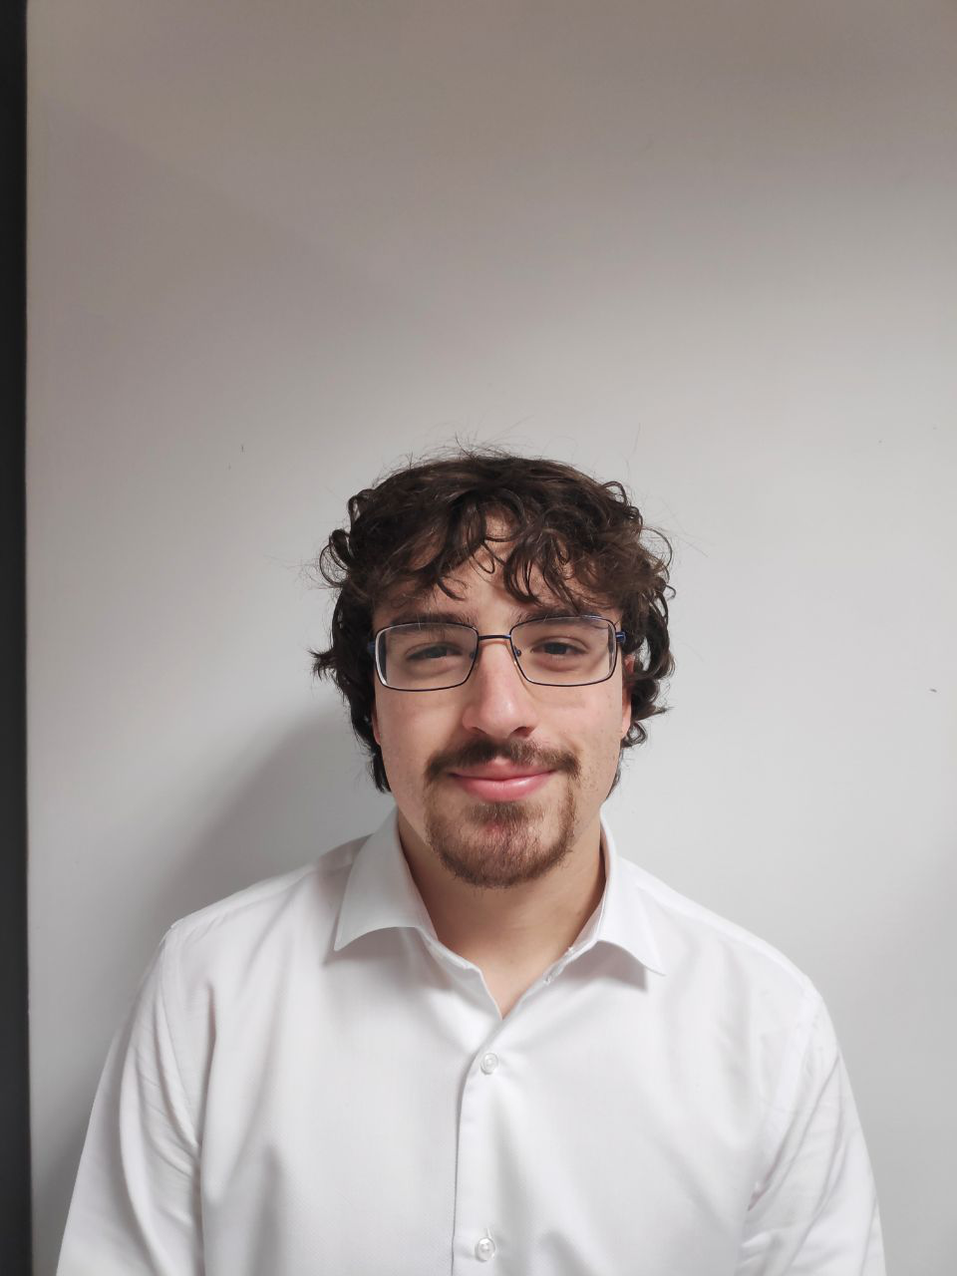
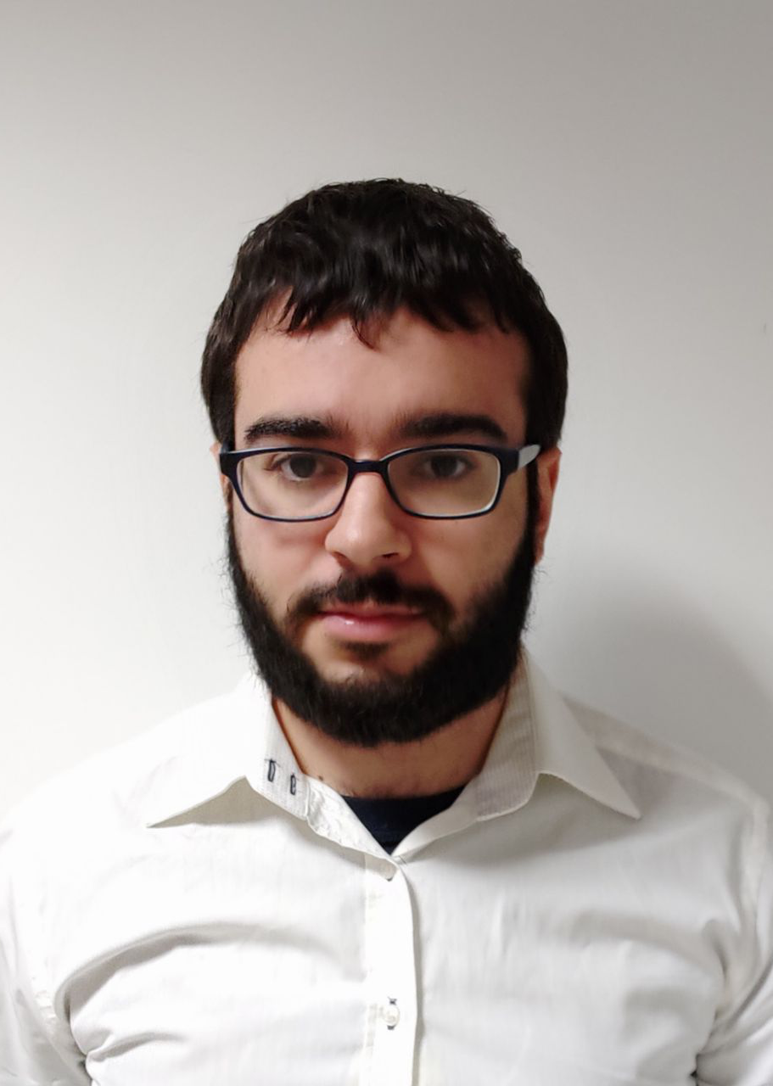
Team composition
Iván Pérez Piñero | Antonio Arenas Arenas | Miguel Santos Batista | Pablo Pazo Jiménez
Backend developer | Frontend developer | Full-stack developer | Backend developer
Notes:
Grupo 7

Slide 30
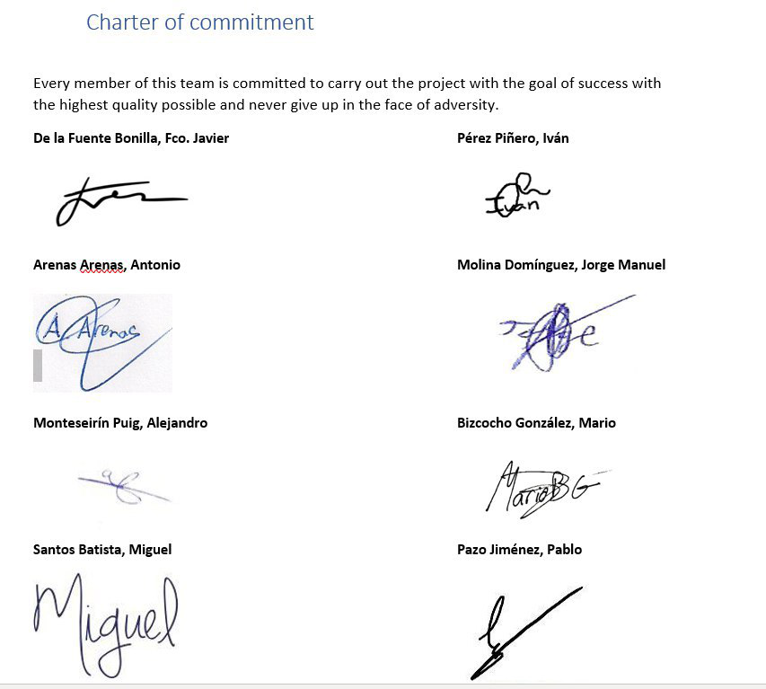
Team composition
Notes:
Grupo 7

Slide 31
Contents
What is Aim Games?
Core use cases
Pilot study
Competitor analysis
Differentiation
Cost and profit analysis
Development plan
Team composition
Technologies

Slide 32


Pilot study
Companies
TieSoft: Rafael Sánchez
Dual Mirror Games: Daniel Marín
Gunstar Studio: Rafael Casaucao
Base members
Alberto Sánchez
Vinnicios Thyago Dias
Francisco Sánchez
… Experience design testers
Anyone can join!
Around 50 members to be polled at street level

Slide 33
Contents
What is Aim Games?
Core use cases
Pilot study
Competitor analysis
Differentiation
Cost and profit analysis
Development plan
Team composition
Technologies

Slide 34
Competitor analysis
 | AIM Games | Linkedin | Infojobs | Stratos | Icaro | Primerempleo | Jobrapido | Trabajos.com | Ibereoempleos
Forum | ✓ | ❌ | ❌ | ✓ | ❌ | ❌ | ❌ | ❌ | ❌
Verify CV | ✓ | ❌ | ❌ | ❌ | ❌ | ❌ | ❌ | ❌ | ❌
Share Resources | ✓ | ❌ | ❌ | ✓ | ❌ | ❌ | ❌ | ❌ | ❌
Direct Messaging | ✓ | ✓ | ❌ | ❌ | ❌ | ❌ | ❌ | ❌ | ❌
Courses | ✓ | ✓ | ✓ | ✓ | ❌ | ✓ | ❌ | ✓ | ✓
Company profiles | ✓ | ❌ | ✓ | ✓ | ✓ | ✓ | € | € | ✓
Sector specific | ✓ | ❌ | ❌ | ✓ | ❌ | ❌ | ❌ | ❌ | ❌
Notes:
AEVI: Asociación Española del Videojuego
STRATOS: offers both job opportunities and collaboration opportunities, the latter do not necessarily involve economical retribution. Also, severe lack of offers in Andalusia. Resembles a forum.
ICARO insecure: GET hacking when editing curricula

Slide 35
Contents
What is Aim Games?
Core use cases
Pilot study
Competitor analysis
Differentiation
Cost and profit analysis
Development plan
Team composition
Technologies

Slide 36
Differentiation
Intuitive design
Credibility
Searchability
Collaboration

Slide 37

Thank you for your time!
If I have seen further it is by standing on the shoulders of Giants
- Isaac Newton
Summer in Mara (Chibig, Valencia, 2019)
Any questions?
Notes:
Grupo 7

